Slide 1







Celebrating our
Differences
Copyright North East Autism Society 2026

Slide 2

Let me ask what does the word ACCEPTANCE mean to you...

Slide 3


Acceptance is...
Understanding that we are all unique Understanding and being OK with someone that is different from you
Being able to be yourself without being worried you will be treated unkindly
Help to make the world a better place for everyone in it

Slide 4

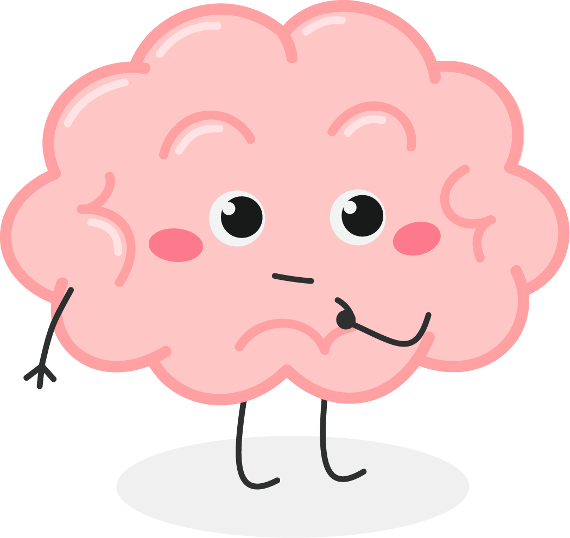


Does anyone know what this is?

Slide 5
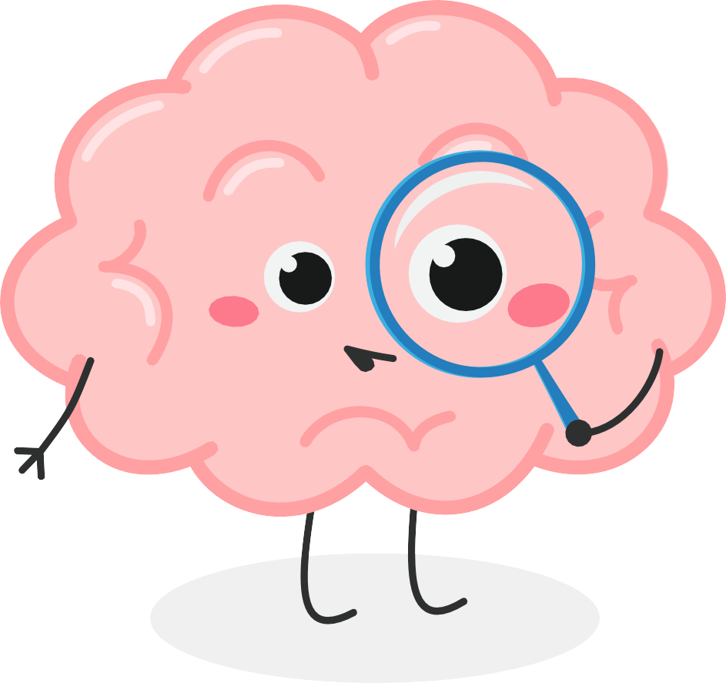
Does anyone know where their brain is in their body?
Does anyone know what our brains do?

Slide 6





Everyone’s brain works differently and there is no right way to think and learn
Some differences in how brains work have been given names like Autism, ADHD and Dyslexia… Have you heard of any of these names?
We are going to work together to understand a little bit about autism.
You may be autistic yourself, or know someone who is

Slide 7




True or False Quiz
Only boys can be autistic
All autistic children do not speak
All autistic children are good at math’s Autistic children are naughty
All autistic children like to be alone

Slide 8
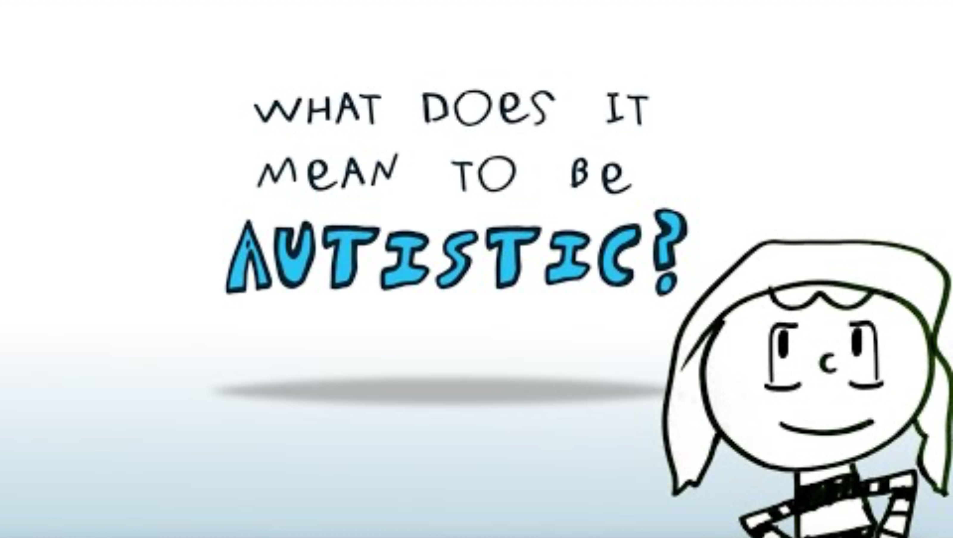

Autism from the Inside Video

Slide 9


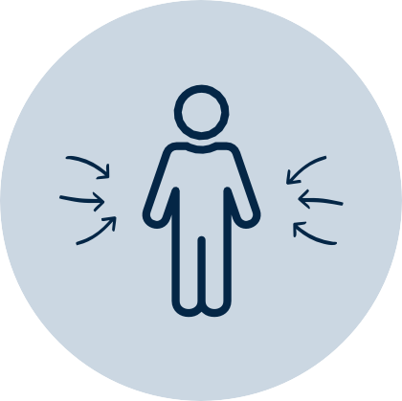
Our Senses
We have eight senses in the body these include:
Smell
Taste
Sight
Touch
Hearing
Interoception
Vestibular
Proprioception

Slide 10

Autistic people might experience sensory information differently...

Slide 11
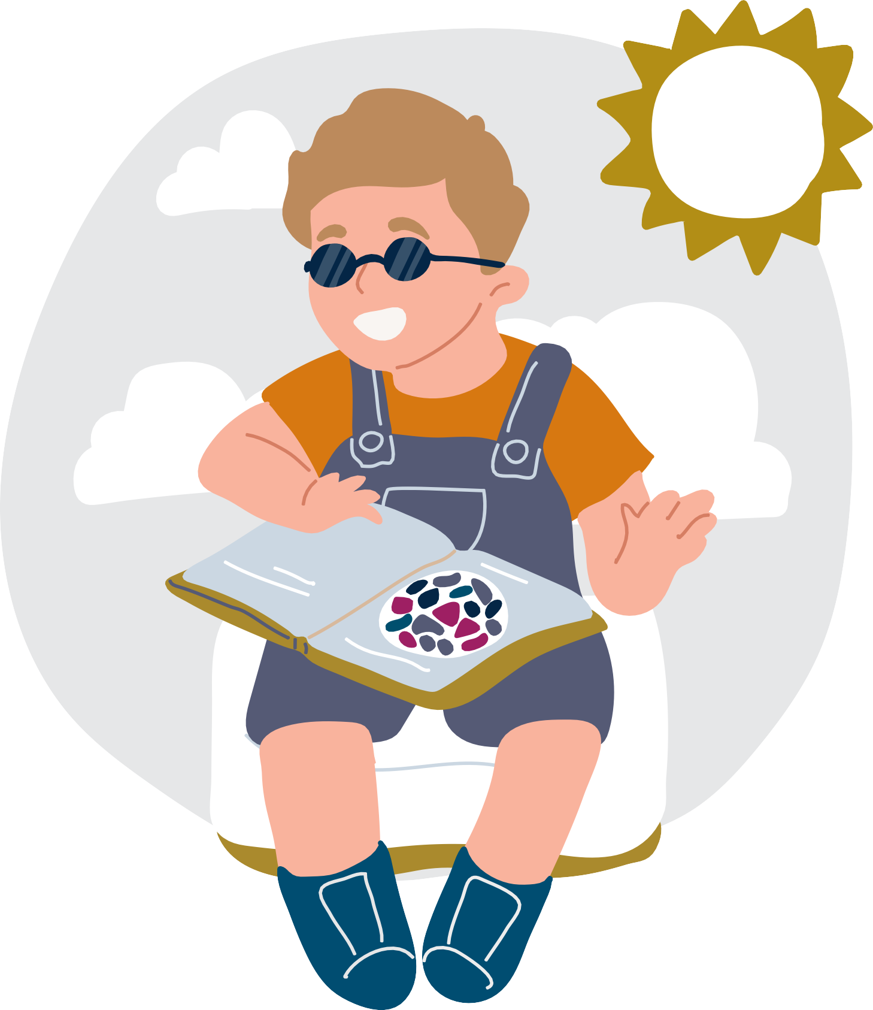
Oscar doesn’t like playing out in the bright sunshine it helps him to wear sun glasses.

Slide 12
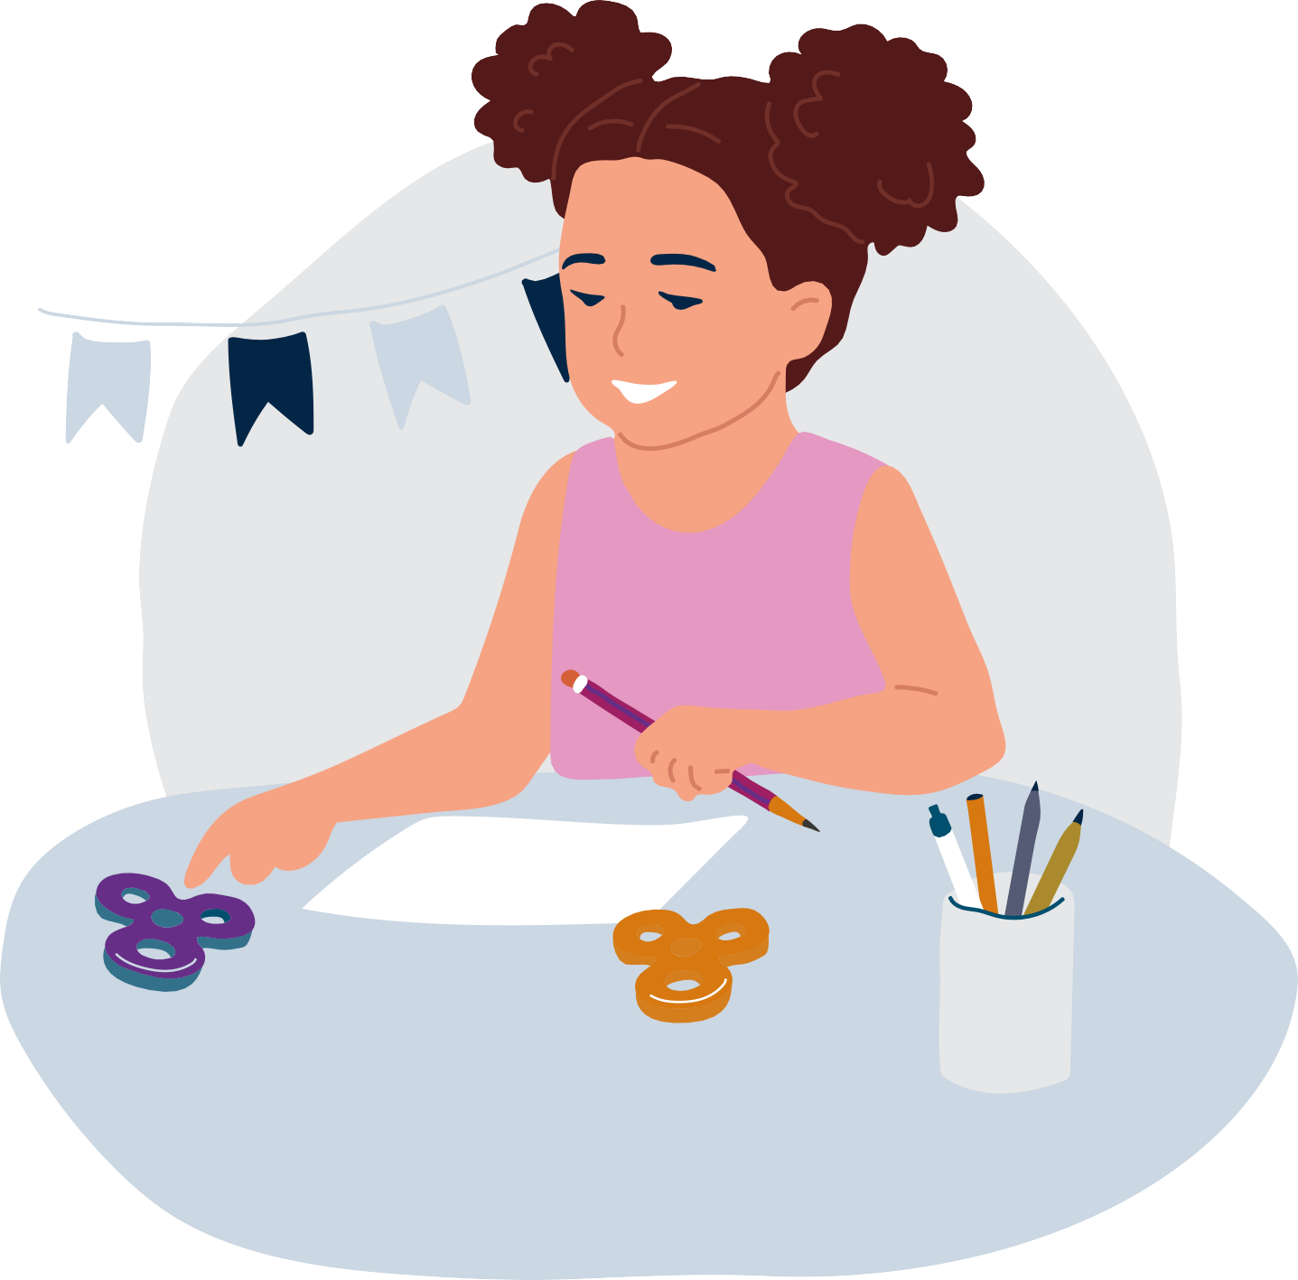
Tilly likes to move when she is in class, this helps her learn. She has a fidget toy and wobbly cushion that helps with this.

Slide 13

Jack can hear noises in the classrooms that you might not hear and this can make him feel worried. He sometimes wears ear defenders to help with this.

Slide 14
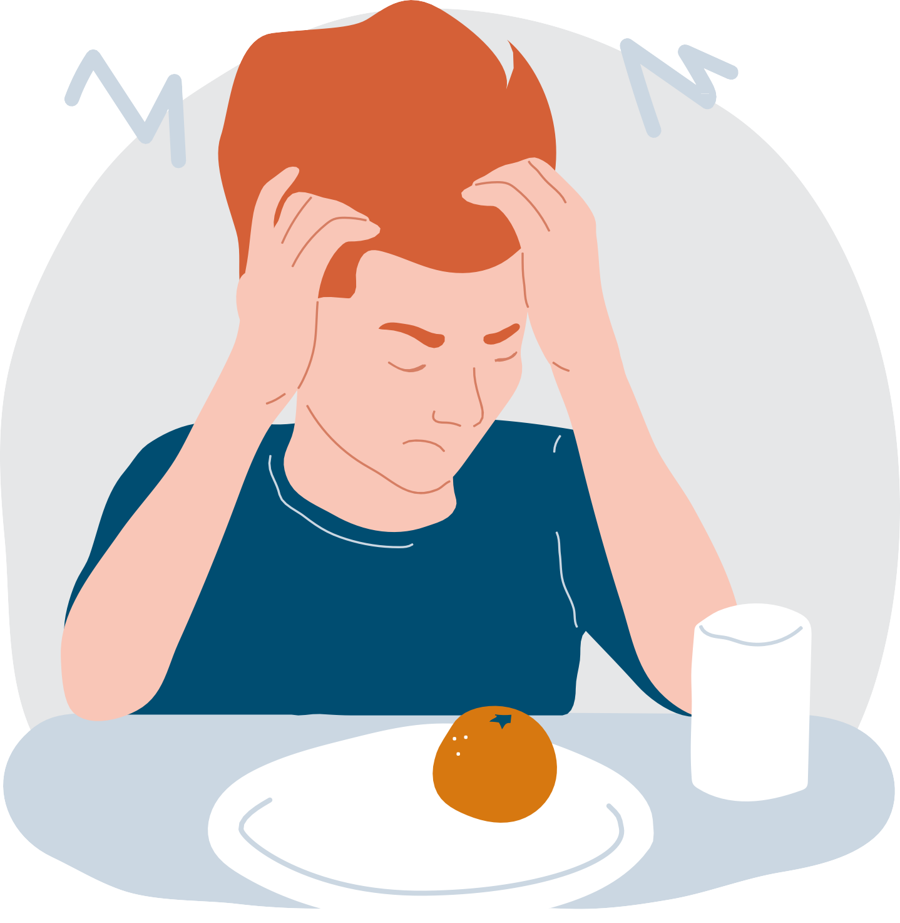
Bobby gets distressed by certain smells, sometimes it can be difficult for him to go into the dinner hall.

Slide 15
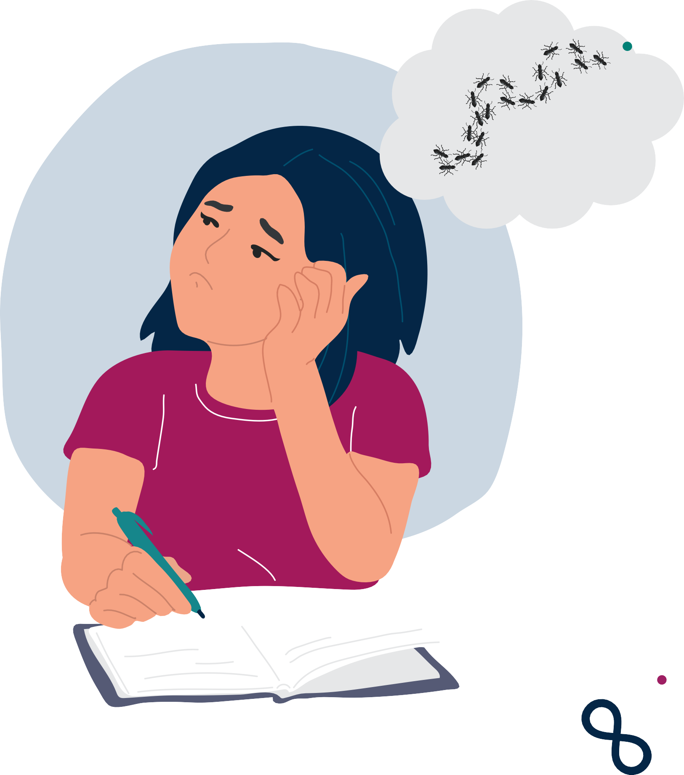
Lilli describes someone touching her arm as
“a thousand ants scratching on her skin”.

Slide 16

Autistic people may communicate differently to someone who is none autistic...

Slide 17

Book!
Tommy likes to communicate using words and sounds.

Slide 18
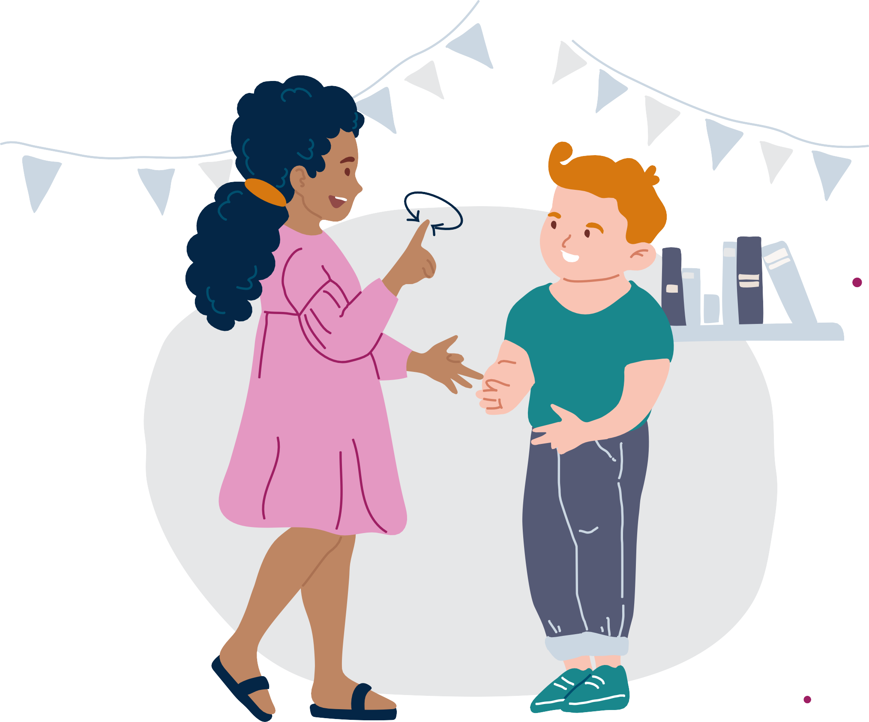
Alice communicates using sign language.

Slide 19
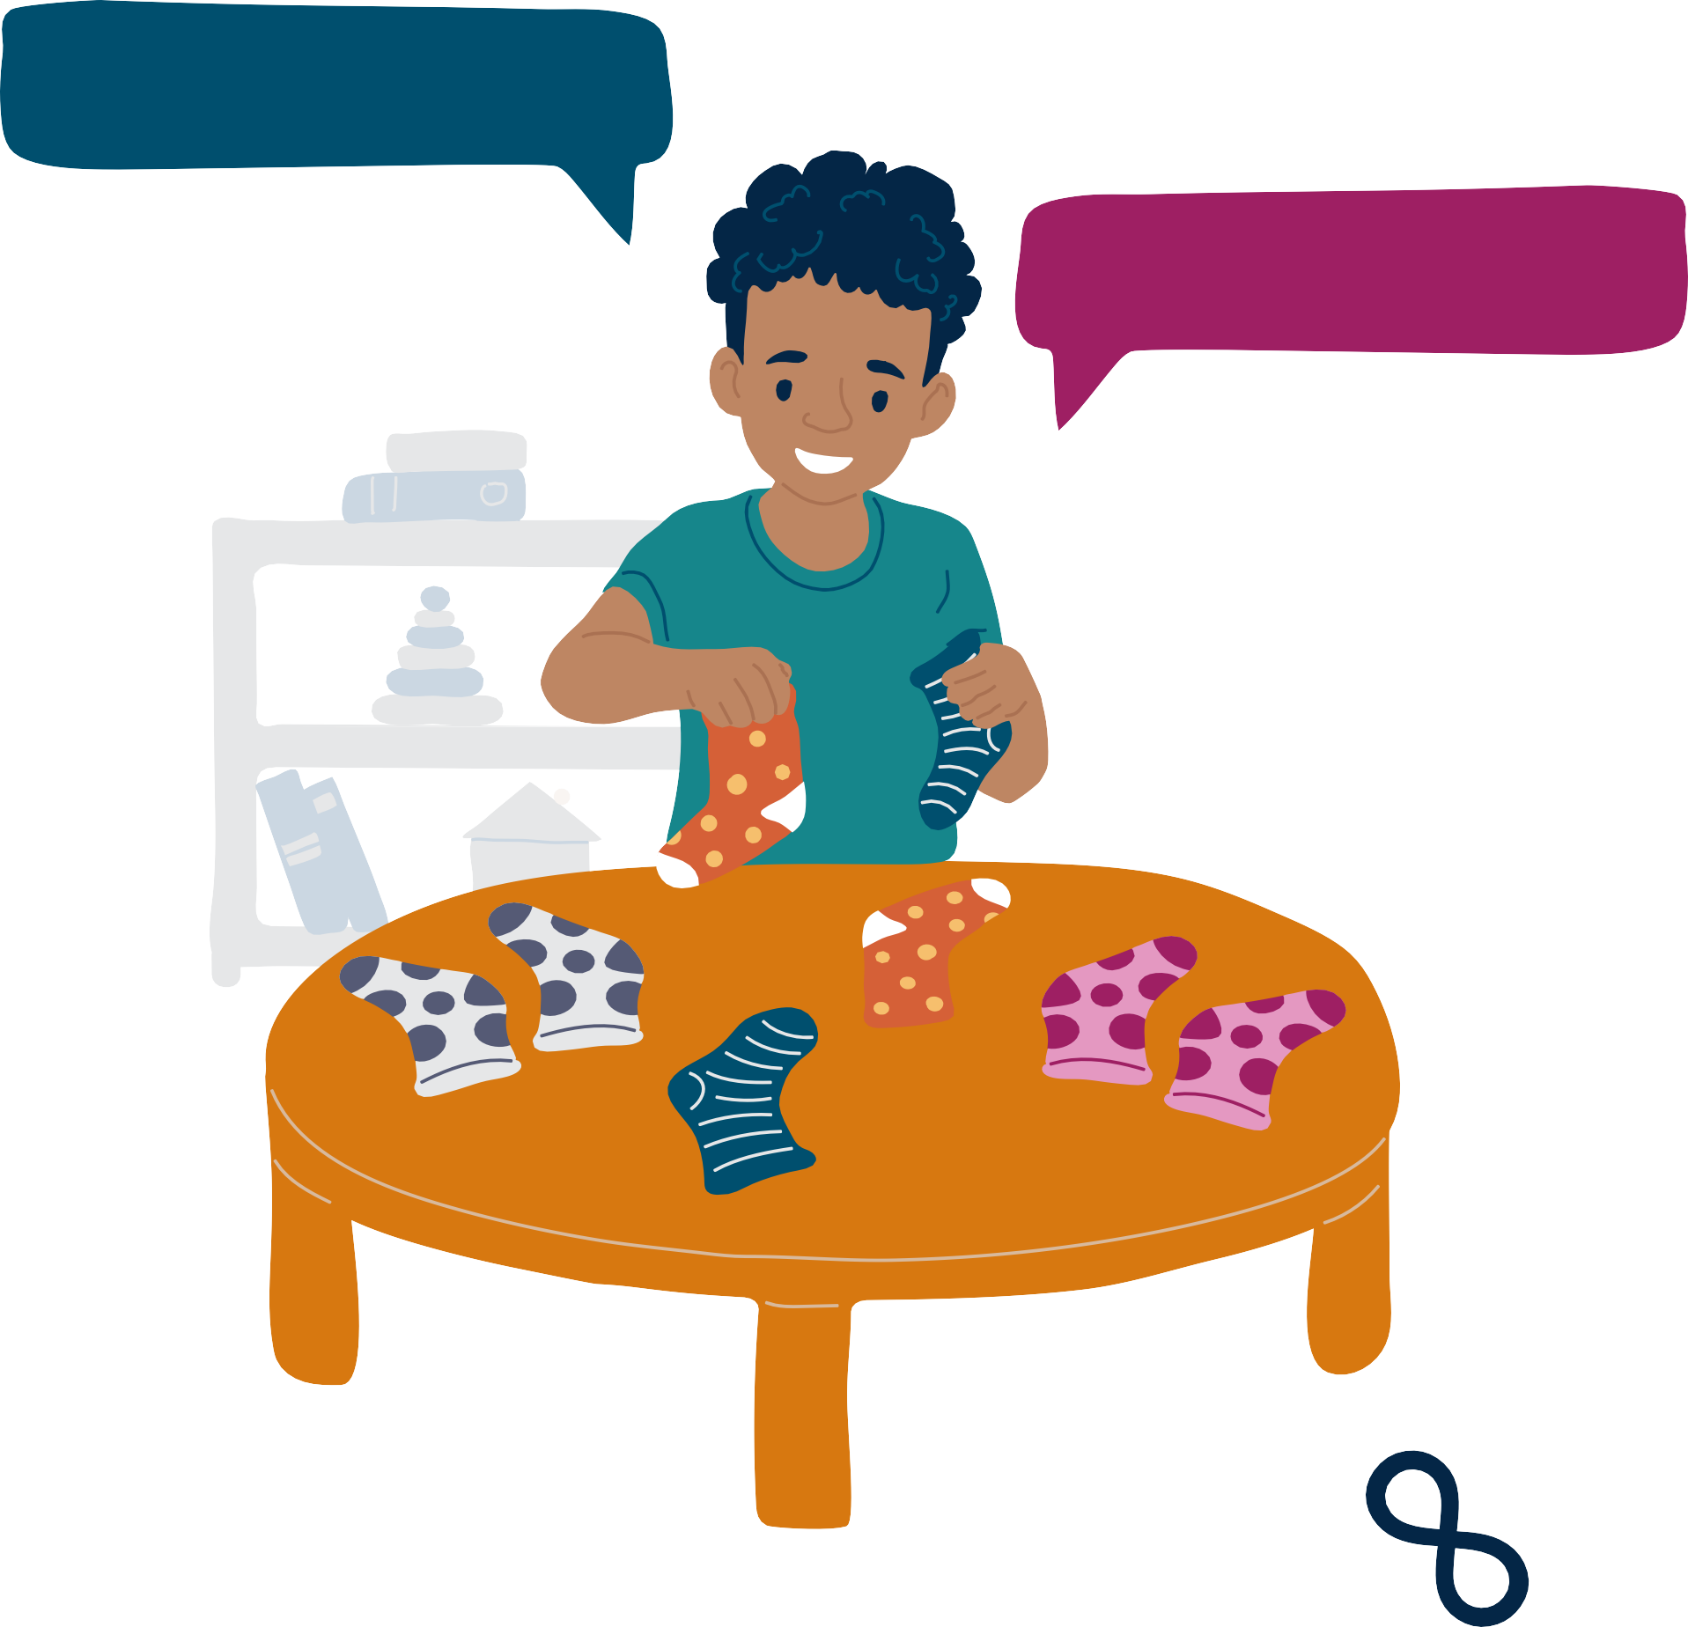
Spotted socks
Spotted socks
Alfie repeats words when he is communicating, this helps him understand.

Slide 20

Poppy likes to write things down, as speaking can make her feel worried.

Slide 21
We are ALL different We are ALL important
We can ALL support each other
We can ALL make the world a better place

Slide 22



Copyright North East Autism Society 2026

